Slide 1
Correlation: Looking for relationships
When the data is scale in nature and want to find out whether there is relationship between the variables or not.
FOR EXAMPLE, whether the time spent in revising is associated to exam performance or whether exam anxiety is associated to exam performance.
Other examples could be whether studying long hours would result into scoring of higher marks in exams.

Slide 2
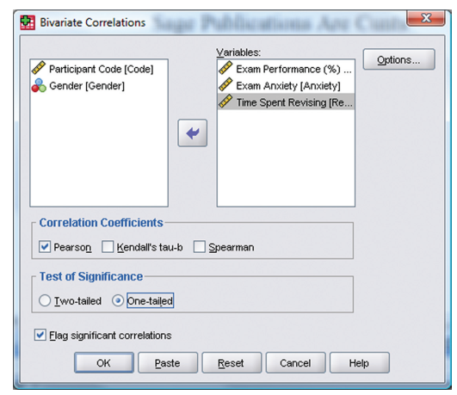
Example: Exam anxiety and performance (Bivariate Correlation)

Slide 3
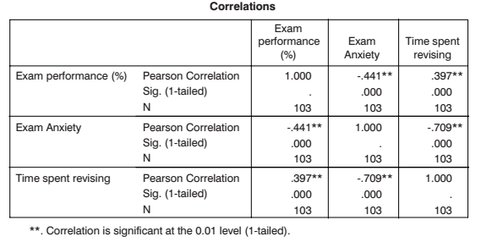

Slide 4
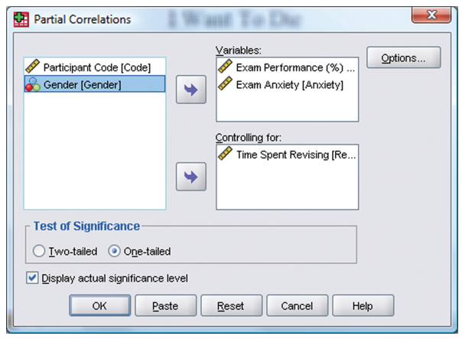
Partial correlation

Slide 5
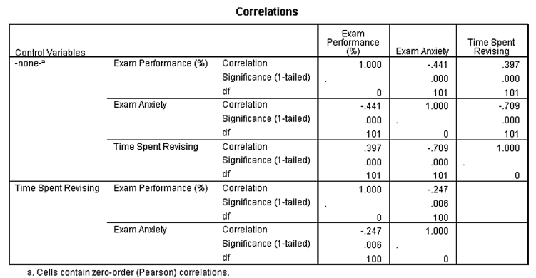
For correlation; effect size should be interpreted taking R square value, for example correlation coefficient of exam performance with exam anxiety is -.441 and to find out r square multiply -.441 X -.441 = 0.194; if you multiply this r square by 100, then it becomes; 19.4% which also means the association between exam performance and exam anxiety is explained upto 19.4% while rest 80.6% is unknown.

Slide 6
Reporting correlation result
Exam performance was significantly correlated with exam anxiety, r = -.44, and time spent revising, r = .40; the time spent revising was also correlated with exam anxiety, r = -.71 (all ps < .001).

